Slide 1
Department of Finance
2025 Year In Review
Presented by Jon Horton, CPA
Director

Slide 2
Department of Finance
Jon Horton, CPA
  Director
Debby Scott
  Senior Accounting Associate
BRigete Davenport
  Accounting Associate II
Felicia Diggs
  Accounting Associate II
  This team has been together since 11/13/2023
Notes:
This entire staff was not present on April 15, 2023. Debby was kind enough to come out of retirement to help us out. The value of her experience and skills cannot be overstated. BRigete came to us from the City of Grand Prairie and assisted with recruiting Felicia from there as well.

Slide 3
Department of Finance
The City’s Finance Department has three main objectives:
Provide timely and materially correct financial reports
Safeguard the financial assets of the City
Ensure those who do business with the City are paid in a timely manner.

Slide 4
Major Projects in 2025
Fiscal year(FY) 24 Annual Comprehensive Financial Report
  Unmodified Opinion issued by Forvis Mazars
FY26 Budget
  Adopted in August 2025
External Storage Elimination
  All eligible contents from offsite storage were destroyed.
Payroll Shift from ADP to Tyler
  Move all outgoing payments onto a single platform
Policy Updates
  The Investment Policy was reviewed per the PFIA
  Purchasing Policy update to modify the City Manager’s spending authority

Slide 5
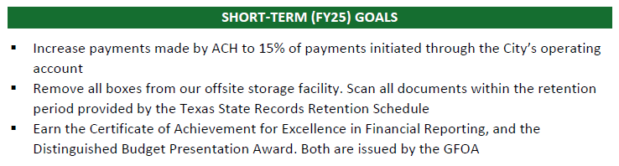
Goals Check-In
As presented in the FY25 Budget:

Slide 6
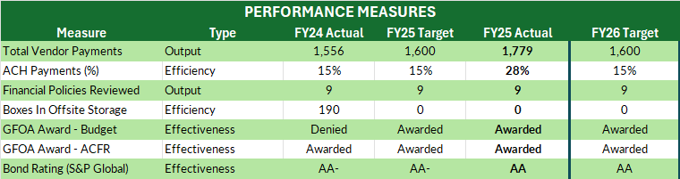
Goals Check-In
As presented in the FY25 Budget:

Slide 7
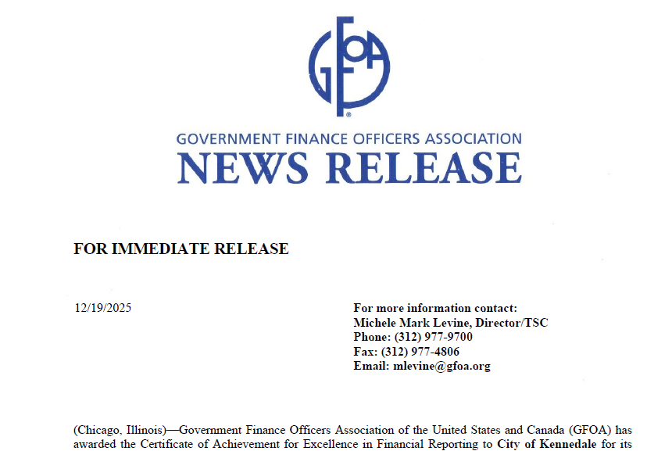
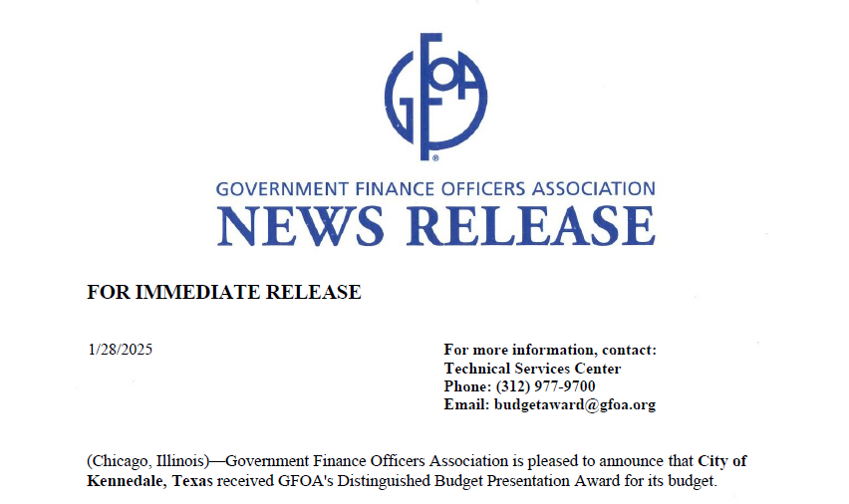
Recognized Efforts
Certificate of Achievement for Excellence in Financial Reporting from the Government Financial Officers Association (second year in a row)
Distinguished Budget Presentation Award from the Government Financial Officers Association

Slide 8
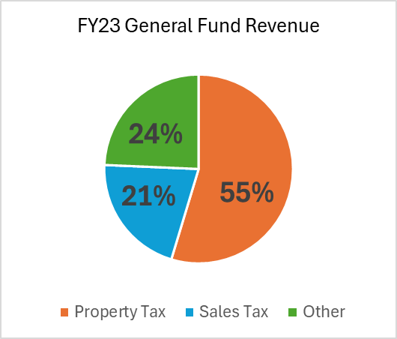
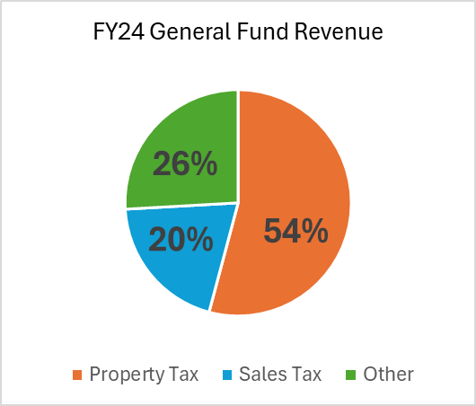
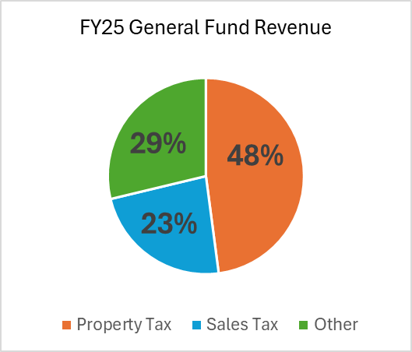
General Fund Revenue Analysis
FY25 Figures are unaudited
Notes:
Other includes Fines and Fees, Charges for Services, Grants and Contributions (FY22 and 23), Intergovernmental, Licenses and Permits, Transfers from other Funds, Investment Revenue, ETC

Slide 9
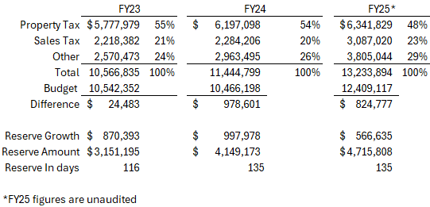
General Fund Revenue Analysis
Other includes Licenses and Permits, Fines and Fees, Chargers for Services, Intergovernmental, Transfers, Investment Income, and Miscellaneous Revenue Sources

Slide 10
General Fund Revenue Analysis
Additional resources from General Fund revenue sources between FY22 and FY26 budgets
  9 new personnel
    Court – 2
    Community Development – 1
    Library – 1
    Fire Department – 2
    Public Works – 3
  New software for Court, Community Development, and Finance
  Pavement Management System for Public Works
  Vehicles Purchased (new): 5 Patrol Vehicles, 1 Animal Control Vehicle, 1 Truck for Community Development, 1 Truck for the Fire Department

Slide 11
Information Technology
2025 Year In Review
Presented by Jon Horton, CPA

Slide 12

In partnership with NetGenius
Service Statistics:
  756 user submitted tickets, all closed
  247 automated system tickets, all closed
  7 hours and 29 minutes of phone calls
    3 hours and 15 minutes of inbound calls
    3 hours and 39 minutes of outbound calls

Slide 13
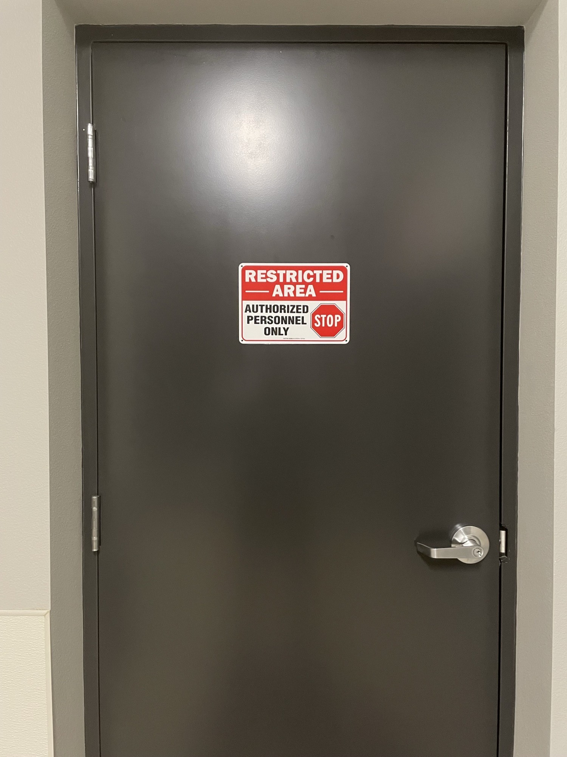
Major Projects in 2025
Tyler deployment assistance
Temporary Fire Station setup
Library cabling moves and fixes
Moving the server room to a secure and structurally sound area
Shift to Microsoft 365
Participation in Emergency Management tabletop exercises

